Slide 1
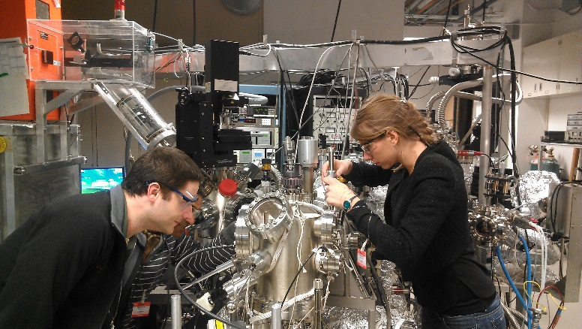
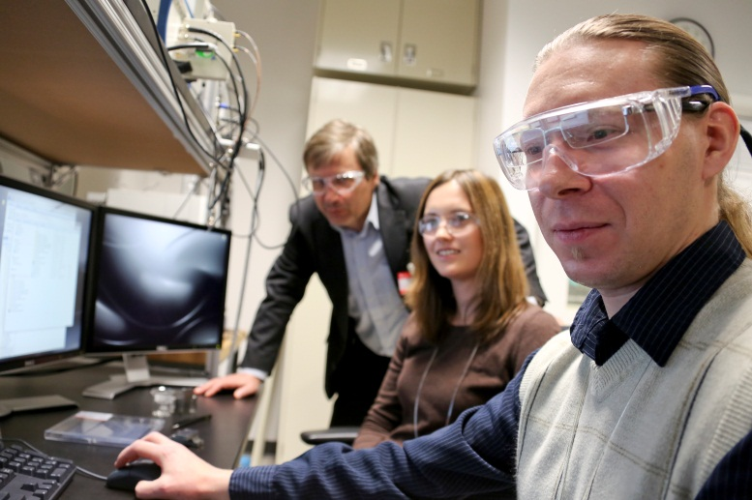
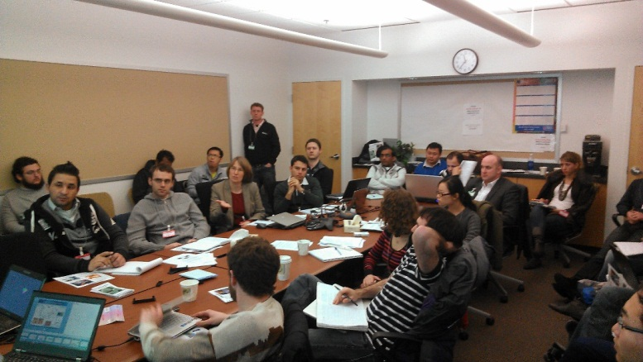
12th International Workshop on Piezoresponse Force Microscopy (PFM):
Theory, Techniques, and Applications
Achievement
Multiple breakthroughs in practice and theory of PFM have recently been achieved in research groups worldwide. The CNMS has led an international workshop as a forum and a development platform for these developments. This workshop provided an in-depth description of recent advances in PFM and offered laboratory demonstrations designed for advanced practitioners. Ultimately, the workshop built a network of PFM specialists and promoted rapid dissemination of theoretical knowledge, experimental protocols, and novel technique development.
Significance
With the rapid technological development and growing interdisciplinary use of atomic force microscopy, intradisciplinary idea exchange is vital. Meetings like the PFM workshop serve as a beacon for students and PIs to explore theoretical and practical solutions to their scientific problems, along with providing fertile ground for starting and strengthening collaborations which continue through our user program.
Details
This workshop was comprised of seminars by discipline experts focusing on principles, cantilever dynamics, contact dynamics, resolution theory and data interpretation. Discussions were coupled with hands on lab demonstrations, including vector PFM, high-frequency PFM, band-excitation and dual frequency resonance tracking imaging, switching spectroscopy PFM and PFM in liquids and vacuum. Applications of PFM for domain imaging, nucleation center mapping, and polarization dynamics in thin films and capacitor structures in ferroelectrics along with electromechanical probing of biological materials, electroactive polymers, and soft-condensed matter were described, demonstrated and discussed.
Notes:
Highlight Narrative Text
(~175 words)
The photochemistry of specific co-factors within the nanoscale hexameric core of photosynthetic reaction centers (RCs), where the initial light-induced charge separation that powers photosynthesis occurs, was determined through polarization selective ultrafast spectroscopy performed on single crystals of RCs. This work is significant because overlapping spectral features of the co-factors within RCs of Rhodobacter sphaeroides have precluded resolution of the spectral and temporal response of the individual co-factors to photon absorption, limiting our understanding of the complex photochemical function in RCs. Using the CNM’s ultrafast transient absorption spectrometers, individual co-factors in RCs from Rh. sphaeroides were monitored through careful orientation of the polarizations of the pump and probe pulses relative to the crystallographic axes of the single crystals. The experiments were performed at 100K to produce additional spectral narrowing and chromophore selectivity. The impact of this work is that the acquisition of transient spectral and kinetic data enabled the cofactor-specific photochemistry to be determined. Furthermore, this work deepens our understanding of the complex photochemical function of RCs, and provides new experimental and data analysis approaches for studying the unusual efficiency of light harvesting and charge separation processes in natural photosystems.
Reference:
“Cofactor-specific Photochemical Function Resolved by Ultrafast Spectroscopy in Photosynthetic Reaction Center Crystals”
L. Huang (Radiation Laboratory, Notre Dame University), N. Ponomarenko (Chemical Sciences & Engineering Division (CSE), Argonne National Laboratory (ANL)), G. P. Wiederrecht (Center for Nanoscale Materials, ANL), D. Tiede (CSE, ANL)
Proc. Nat. Acad. Sci. 109, 4851 (2012).
Acknowledgment of Support:
L.H. was supported by the Division of Chemical Sciences, Geosciences and Biosciences, Office of Basic Energy Sciences of the US Department of Energy through grant DE-FC02-04ER15533. N.P. and D.M.T. were supported by the Division of Chemical Sciences, Geosciences, and Biosciences, Office of Basic Energy Sciences of the U.S. Department of Energy under contract DE-AC02-06CH11357. Use of the Center for Nanoscale Materials was supported by the U.S. Department of Energy, Office of Science, Office of Basic Energy Sciences under Contract No. DE-AC02-06CH11357.

Slide 2
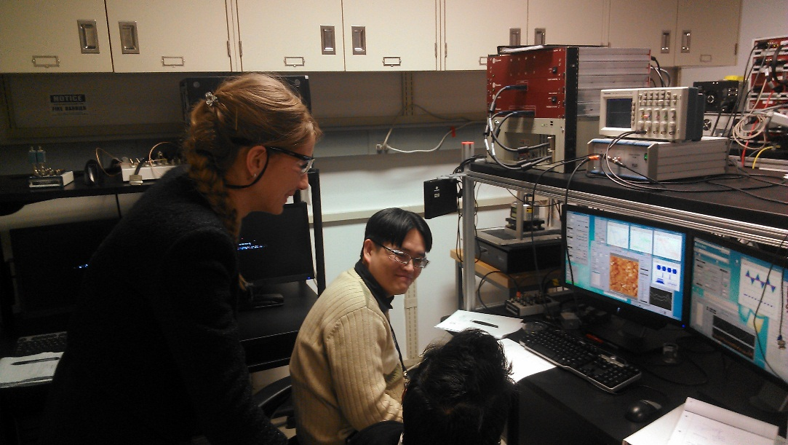
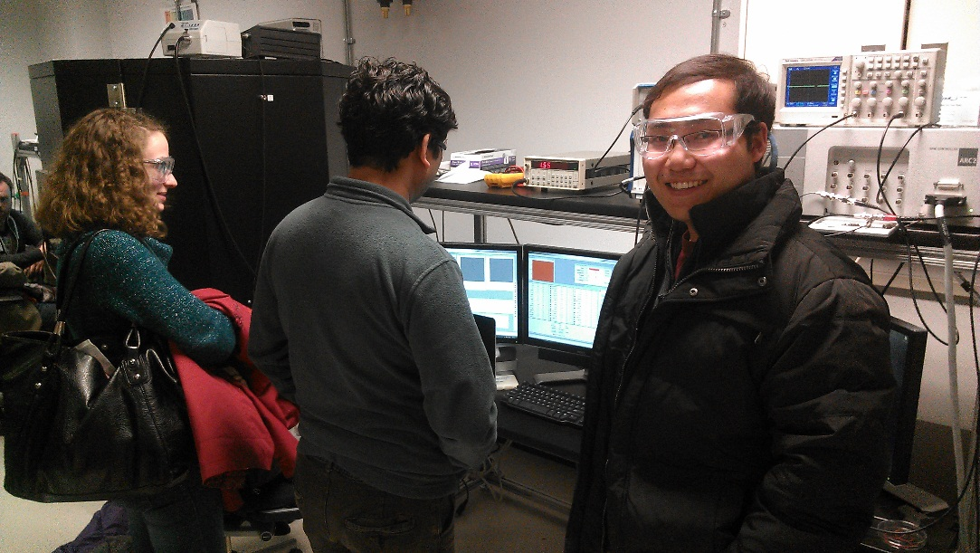
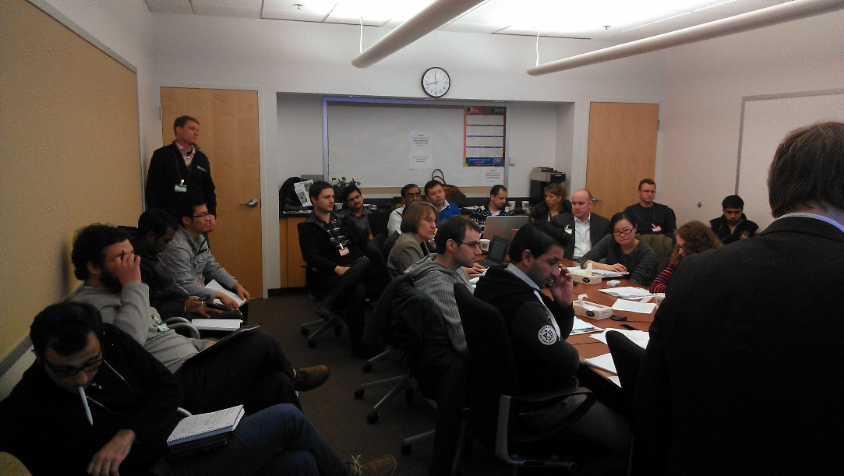

Slide 3
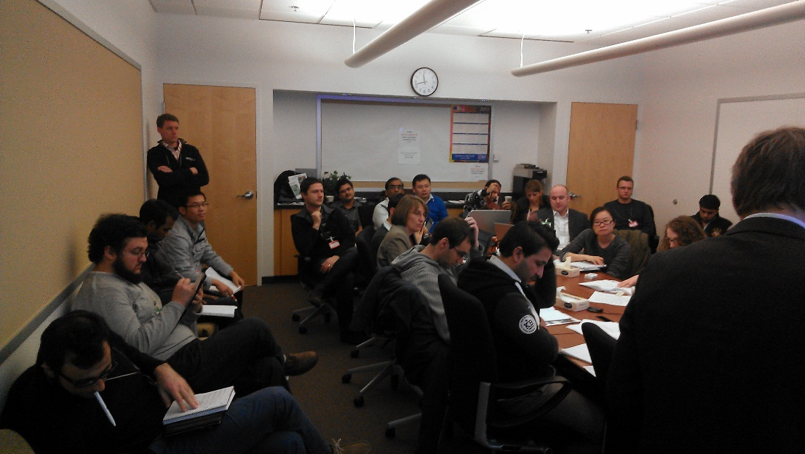
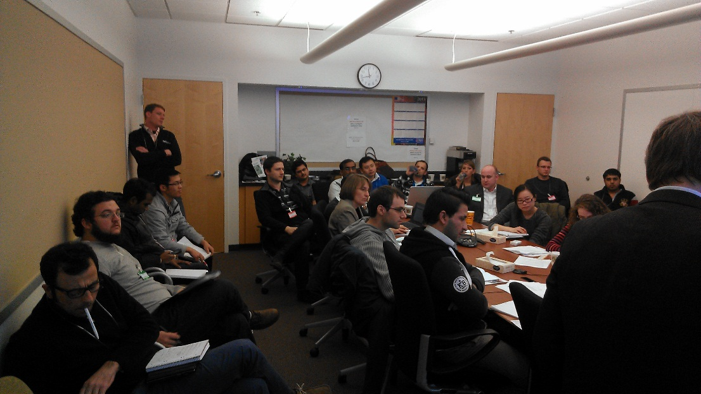
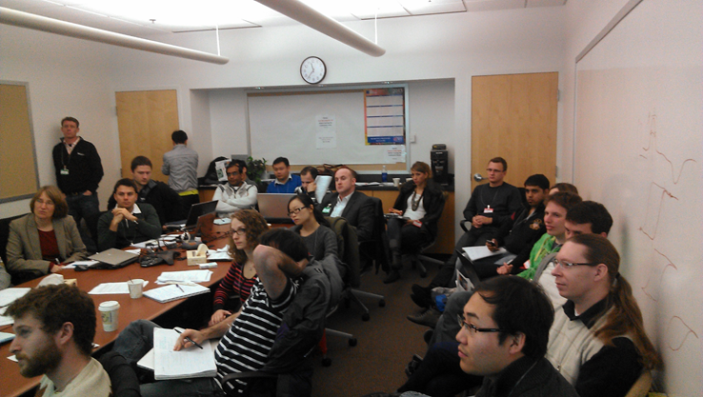

Slide 4
